Slide 1
Chapter 10
Component-Level Design
These slides are designed to accompany Software Engineering: A Practitioner’s Approach, 7/e (McGraw-Hill, 2009). Slides copyright 2009 by Roger Pressman.

Slide 2
What is a Component?
OMG Unified Modeling Language Specification [OMG01] defines a component as
  “… a modular, deployable, and replaceable part of a system that encapsulates implementation and exposes a set of interfaces.””
OO view: a component contains a set of collaborating classes
Conventional view: a component contains processing logic, the internal data structures that are required to implement the processing logic, and an interface that enables the component to be invoked and data to be passed to it.
These slides are designed to accompany Software Engineering: A Practitioner’s Approach, 7/e (McGraw-Hill, 2009). Slides copyright 2009 by Roger Pressman.

Slide 3
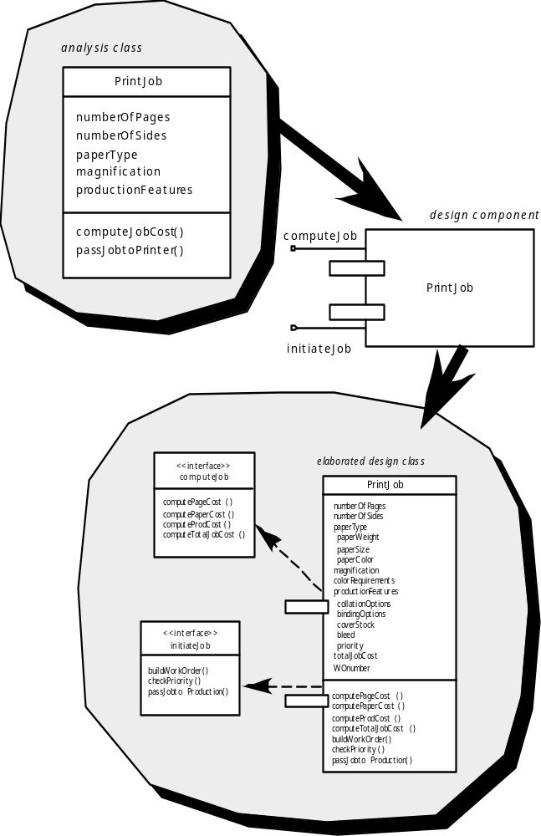
OO Component
These slides are designed to accompany Software Engineering: A Practitioner’s Approach, 7/e (McGraw-Hill, 2009). Slides copyright 2009 by Roger Pressman.

Slide 4
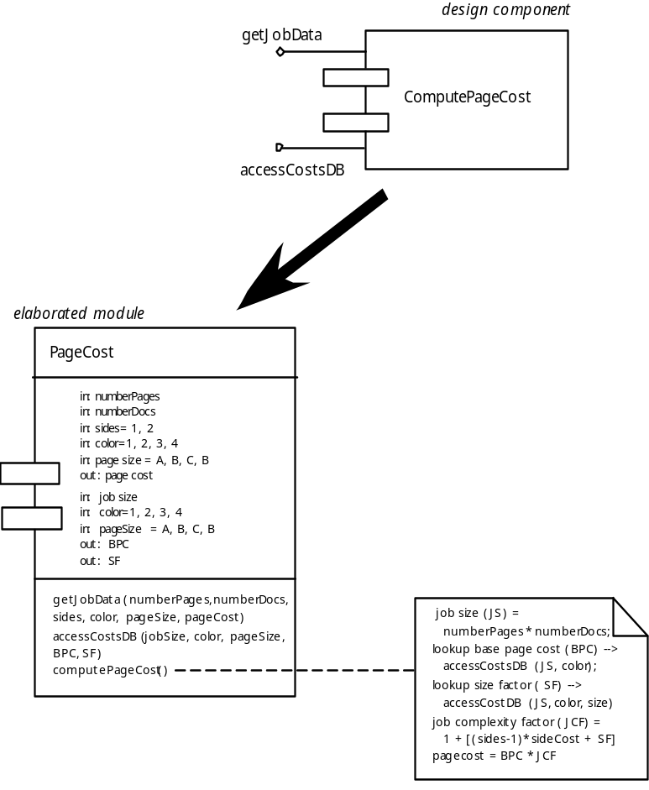
Conventional Component
These slides are designed to accompany Software Engineering: A Practitioner’s Approach, 7/e (McGraw-Hill, 2009). Slides copyright 2009 by Roger Pressman.

Slide 5
Design Guidelines
Components
  Naming conventions should be established for components that are specified as part of the architectural model and then refined and elaborated as part of the component-level model
Interfaces
  Interfaces provide important information about communication and collaboration (as well as helping us to achieve the OCP)
Dependencies and Inheritance
  it is a good idea to model dependencies from left to right and inheritance from bottom (derived classes) to top (base classes).
These slides are designed to accompany Software Engineering: A Practitioner’s Approach, 7/e (McGraw-Hill, 2009). Slides copyright 2009 by Roger Pressman.

Slide 6
Cohesion
Conventional view:
  the “single-mindedness” of a module
OO view:
  cohesion implies that a component or class encapsulates only attributes and operations that are closely related to one another and to the class or component itself
Levels of cohesion
  Functional
  Layer
  Communicational
  Sequential
  Procedural
  Temporal
  utility
These slides are designed to accompany Software Engineering: A Practitioner’s Approach, 7/e (McGraw-Hill, 2009). Slides copyright 2009 by Roger Pressman.

Slide 7
• Temporal cohesion – operations are performed to reflect a specific behavior or state
• Procedural cohesion – components grouped to allow one be invoked immediately after the preceding one was invoked with or without passing data
• Communicational cohesion –operations required same data are grouped in same class
• Sequential cohesion – components grouped to allow input to be passed from first to second and so on
These slides are designed to accompany Software Engineering: A Practitioner’s Approach, 7/e (McGraw-Hill, 2009). Slides copyright 2009 by Roger Pressman.

Slide 8
• Layer cohesion – exhibited by package components when a higher level layer accesses the services of a lower layer, but lower level layers do not access higher level layer services
• Functional cohesion – module performs one and only one function
These slides are designed to accompany Software Engineering: A Practitioner’s Approach, 7/e (McGraw-Hill, 2009). Slides copyright 2009 by Roger Pressman.

Slide 9
Coupling
Conventional view:
  The degree to which a component is connected to other components and to the external world
OO view:
  a qualitative measure of the degree to which classes are connected to one another
Level of coupling
  Content
  Common
  Control
  Stamp
  Data
  Routine call
  Type use
  Inclusion or import
  External
These slides are designed to accompany Software Engineering: A Practitioner’s Approach, 7/e (McGraw-Hill, 2009). Slides copyright 2009 by Roger Pressman.

Slide 10
• Content coupling – occurs when one component secretly modifies internal data in another component
• Common coupling – occurs when several components make use of a global variable
• Control coupling – occurs when one component passes control flags as arguments to another
• Stamp coupling – occurs when parts of larger data structures are passed between components
•
These slides are designed to accompany Software Engineering: A Practitioner’s Approach, 7/e (McGraw-Hill, 2009). Slides copyright 2009 by Roger Pressman.

Slide 11
Data coupling – occurs when long strings of arguments are passed between components
• Routine call coupling – occurs when one operator invokes another
• Type use coupling – occurs when one component uses a data type defined in another
• Inclusion or import coupling – occurs when one component imports a package or uses the content of another
• External coupling – occurs when a components communications or collaborates with infrastructure components (e.g. database

Slide 12
Exercise
What is component ? Explain conventional and OO component with figure
Explain different levels of cohesion
Explain different level of coupling
These slides are designed to accompany Software Engineering: A Practitioner’s Approach, 7/e (McGraw-Hill, 2009). Slides copyright 2009 by Roger Pressman.

